Slide 1
CAPSTONE PROJECT
TELECOM CHURN ANALYSIS
PRESENTED BY:
MOHAMMAD IBRAHIM A
THANTHAI PERIYAR GOVERNMENT INSTITUTE OF TECHNOLOGY
CIVIL ENGINEERING.

Slide 2
OUTLINE
Problem Statement
Proposed System/Solution
System Development Approach
Algorithm & Deployment
Result
Conclusion
Future Scope
References

Slide 3
PROBLEM STATEMENT
Orange S.A., formerly France Télécom S.A., is a French multinational telecommunications corporation. The Orange Telecom's Churn Dataset, consists of cleaned customer activity data (features), along with a churn label specifying whether a customer cancelled the subscription. Explore and analyze the data to discover key factors responsible for customer churn and come up with ways/recommendations to ensure customer retention.

Slide 4
PROPOSED SOLUTION
Analyze exploratory data to identify important consumer characteristics and churn trends.
Determine the important churn predictors, including service interactions, demographics, and usage patterns.
To take preventative action, use machine learning models to forecast churn risk.
Put into practice tailored retention tactics, such as loyalty plans and focused marketing.
Ensure that customer support is accessible and of high quality to quickly resolve issues.
Use predictive analytics to foresee and stop at-risk clients from leaving.
Improve service offerings in response to consumer input and preferences.
Create client segments based on churn patterns to implement customized retention strategies.
Track churn patterns over time to adjust tactics and meet changing demands from clients.
Retention campaigns should be improved and iterated often to keep a foundation of devoted customers.

Slide 5
SYSTEM APPROACH
1.Hardware prerequisites:
It can be necessary for you to have a computer with enough processing power and memory, depending on the size of the dataset and complexity of the analysis.
A computer with a multicore CPU (such as an AMD Ryzen series or an Intel Core i7) and lots of RAM (such as 16GB or more) would be useful for large-scale analysis and simulation.
Take into account the amount of storage needed to hold datasets and model results. High-capacity hard disk drives (HDDs) or solid-state drives (SSDs) can be required.
2.Web browser:
Dashboards, online platforms for data analysis, and data visualization tools all require a contemporary web browser.
For web-based data analysis tools, popular browsers like Google Chrome, Mozilla Firefox, Microsoft Edge, or Safari are frequently utilized.
3.System and Software Requirements:
Tools for Data Analysis: Make use of software programs and libraries for python.

Slide 6
ALGORITHM & DEPLOYMENT
1.Selection of Algorithms:
Select suitable machine learning methods, such Logistic Regression, for churn prediction.
Decision Trees
Unexpected Woods
GBMs, or gradient boosting machines
Deep Learning, for example, uses neural networks and support vector machines (SVM).
2.Preparing data:
Scale numerical features, handle missing values, and encode categorical variables to clean up and preprocess the dataset.
To evaluate the model, divide the dataset into training and testing sets.
3.Training Models:
Utilizing the training dataset, train the chosen machine learning algorithms.
To maximize model performance, adjust hyperparameters with methods like grid search or random search.
4.Assessment of the Model:
Use relevant assessment measures, such as F1-score, ROC-AUC, accuracy, precision, and recall, to assess the trained models.
Make use of methods like cross-validation to make sure the model is robust.
5.Interpretation of the Model:
Examine the trained models to determine the significance of churn.

Slide 7
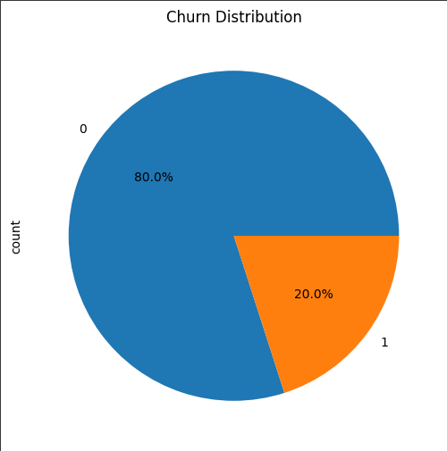
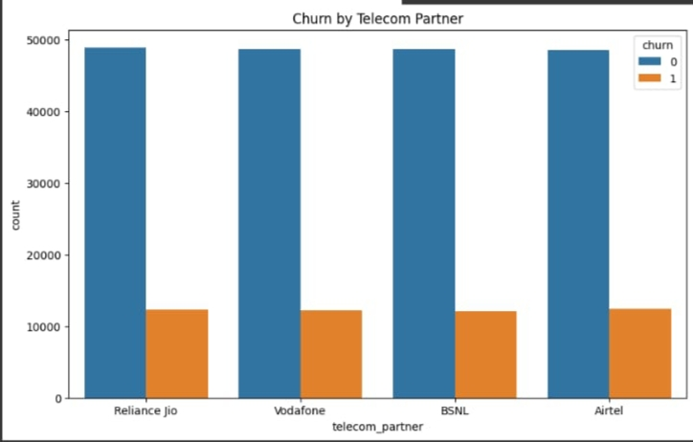
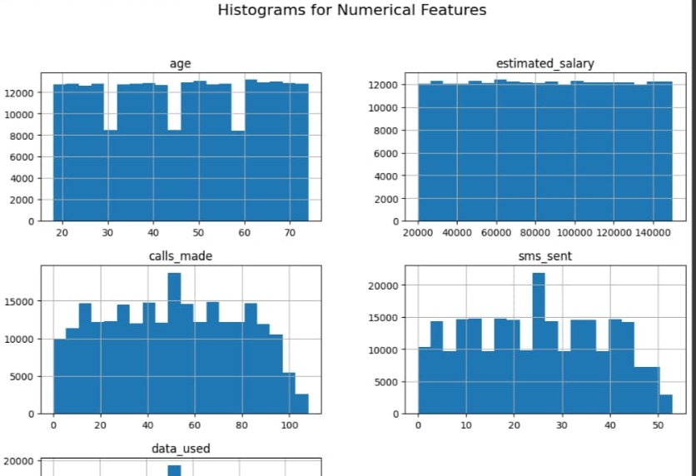
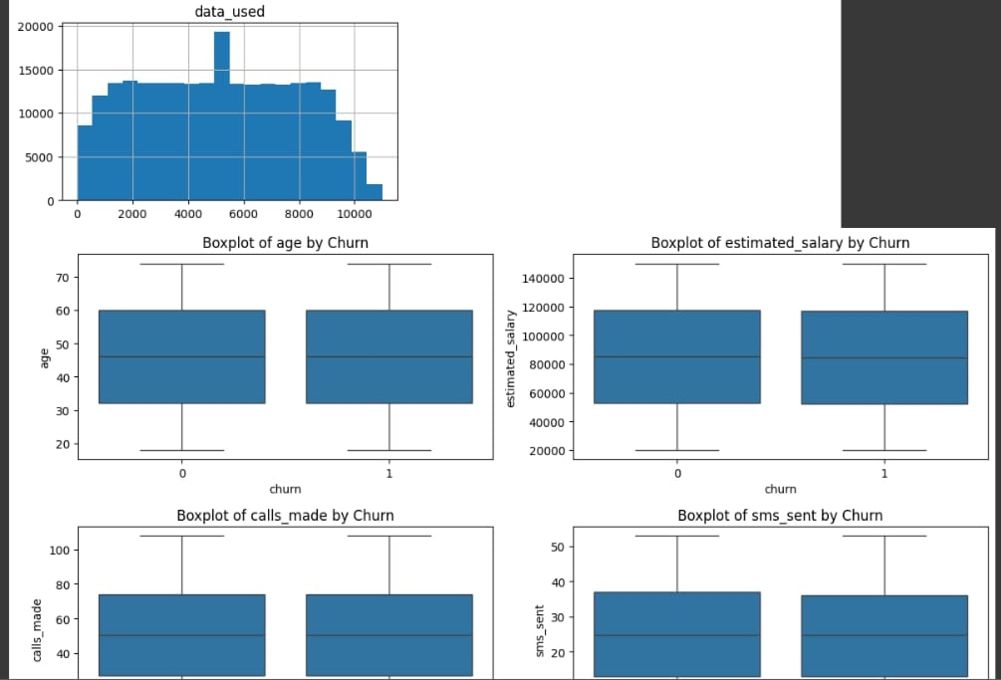
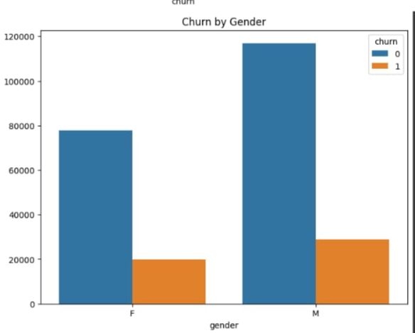
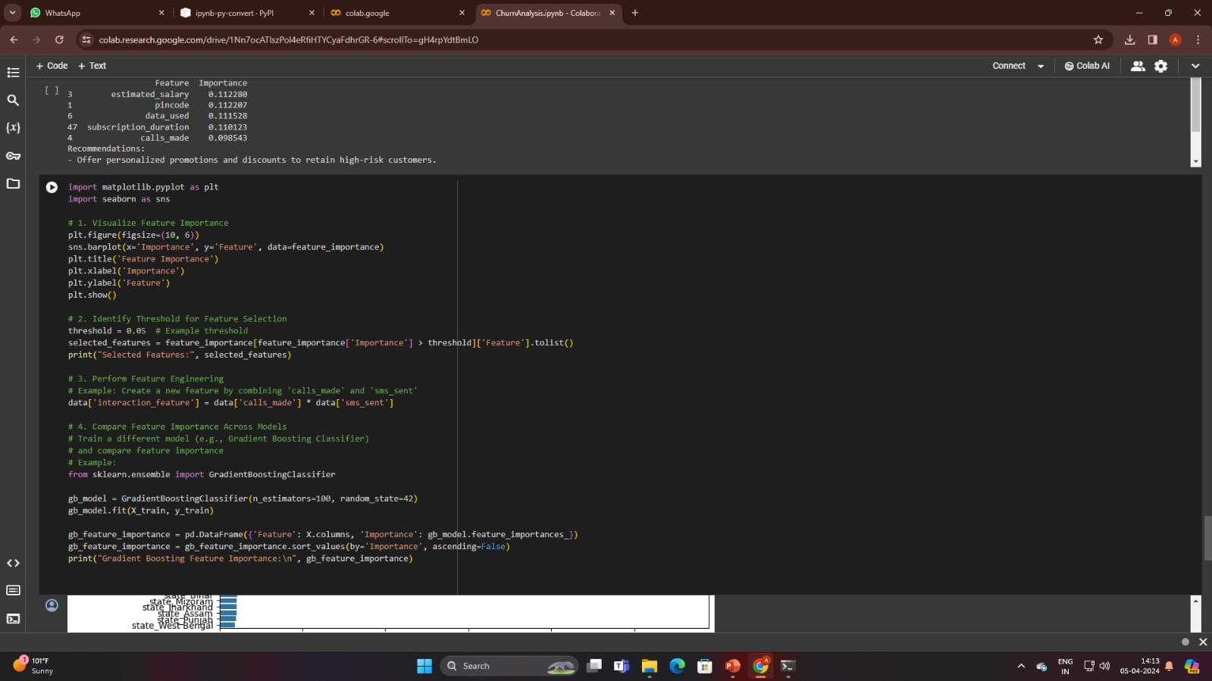
RESULT

Slide 8
CONCLUSION
In summary, our churn study provides a solid basis for well-informed choices and preemptive steps to mitigate customer loss. We can build enduring relationships with our customers and promote sustainable business success by utilizing data-driven insights and giving customer-centric initiatives first priority.

Slide 9
FUTURE SCOPE
Of course, the following recommendations pertain to the future range of this churn analysis:
Predictive Modeling Refinement:
Apply cutting-edge machine learning algorithms, including neural networks or ensemble approaches, to improve predictive modeling procedures. This could facilitate proactive intervention techniques and increase the accuracy of churn estimates.
Integrate real-time data streams from several sources, including customer feedback, app usage, and website engagements. This will make the churn prediction system more responsive and dynamic, enabling prompt intervention techniques.
Segmentation Analysis:
To pinpoint particular customer segments with distinctive churn preferences and behaviors, conduct additional segmentation analysis. Optimizing ROI and maximizing efficacy can be achieved by customizing pricing models and retention methods to these categories.
Leverage Natural Language Processing (NLP):
To examine unstructured data, apply NLP techniques.

Slide 10
REFERENCES
https://github.com/vigneshmuthuvelan/DataScienceProject.git
https://pandas.pydata.org/pandas-docs/stable/user_guide/index.html
https://www.kaggle.com/datasets
https://seaborn.pydata.org/
https://matplotlib.org/stable/contents.html

Slide 11
THANK YOU

